Slide 1
Team 5900 Programmer’s Notebook
By Conrad Fernandez

Slide 2
How do I get started?
Let’s go through the process of creating a brand new program from scratch.
First, open Visual Studio Code.

Slide 3
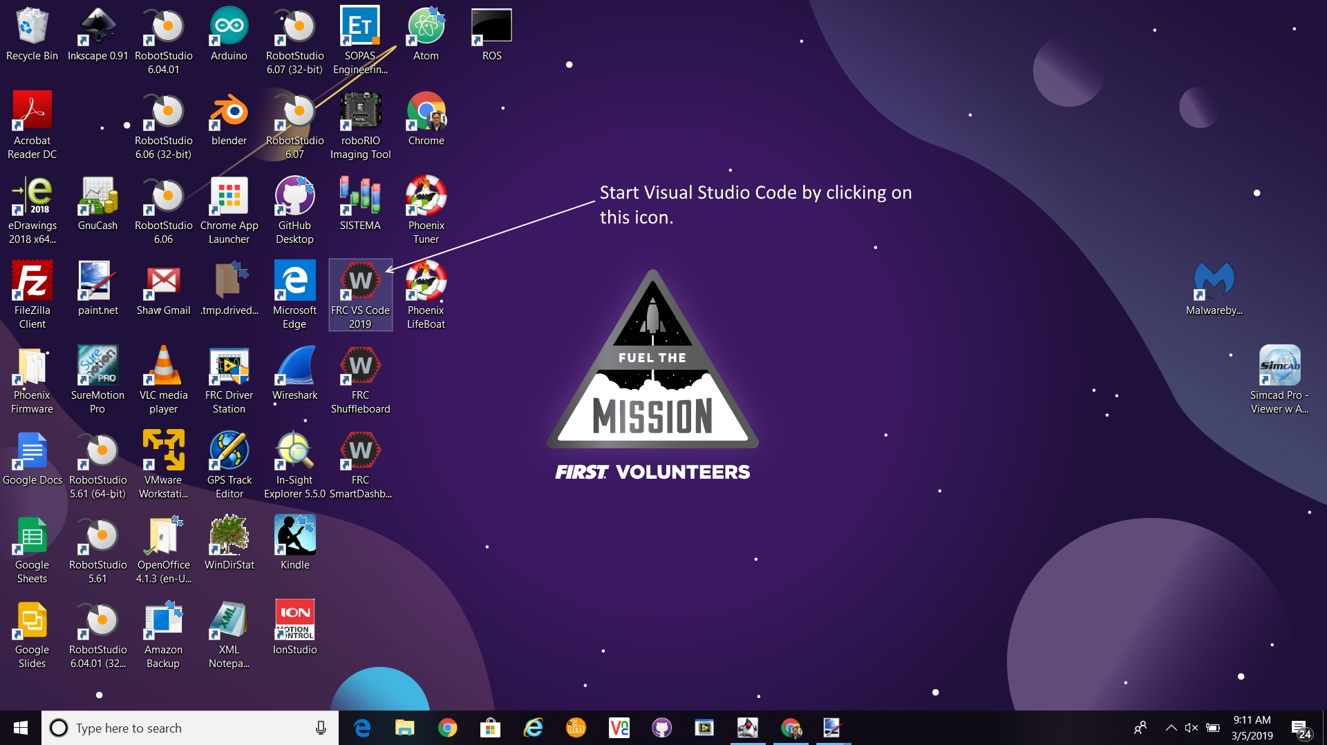

Slide 4
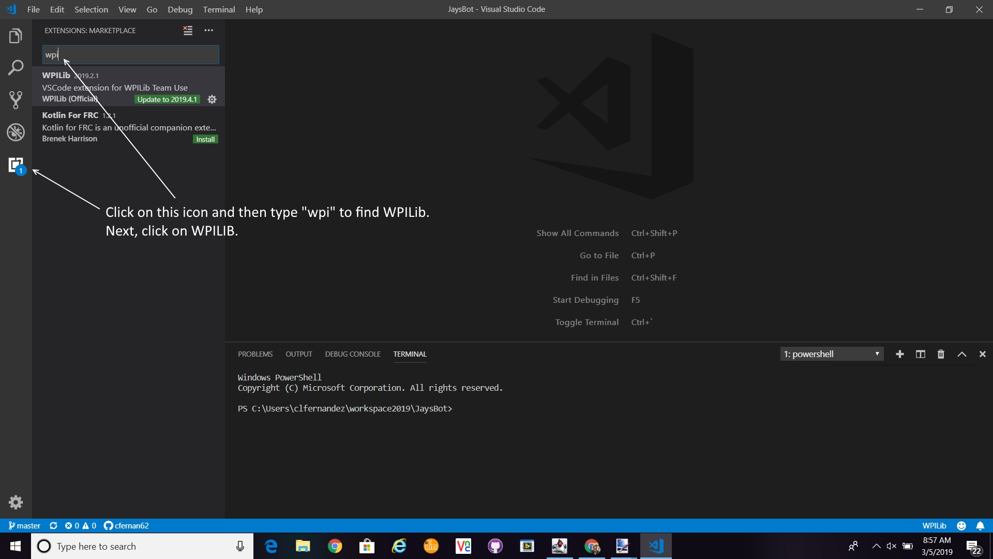

Slide 5
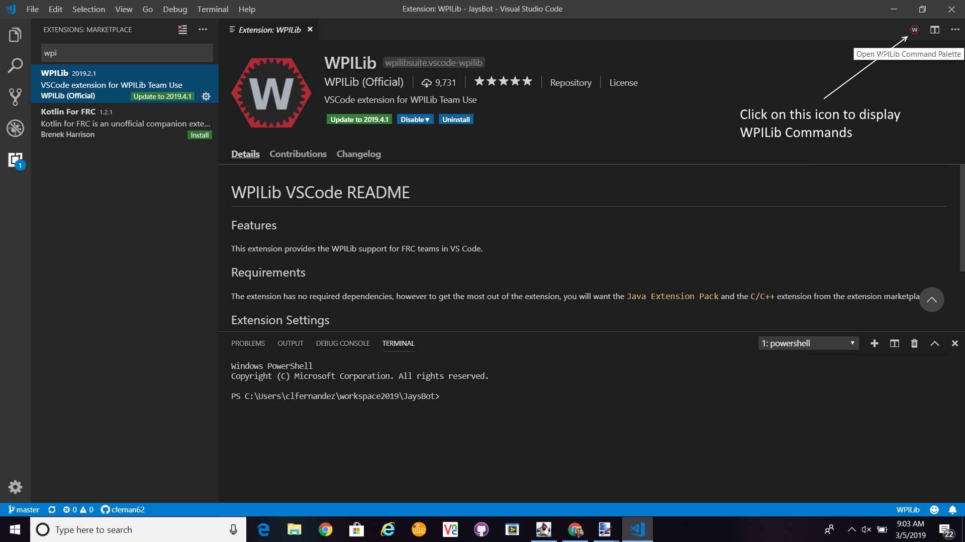

Slide 6
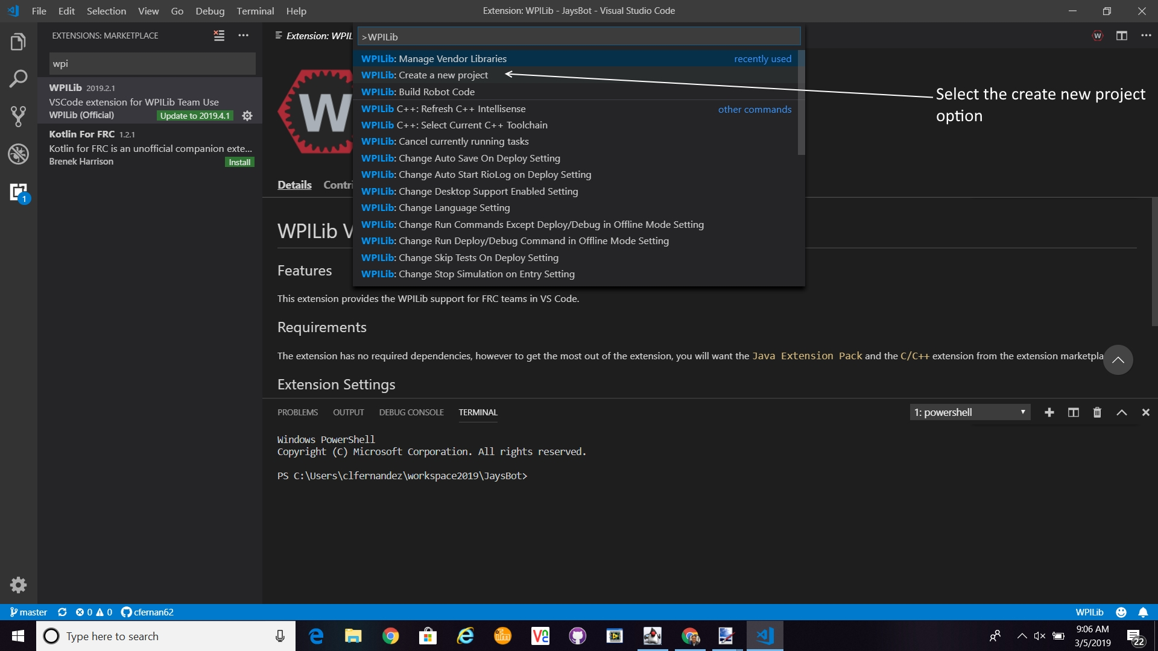

Slide 7
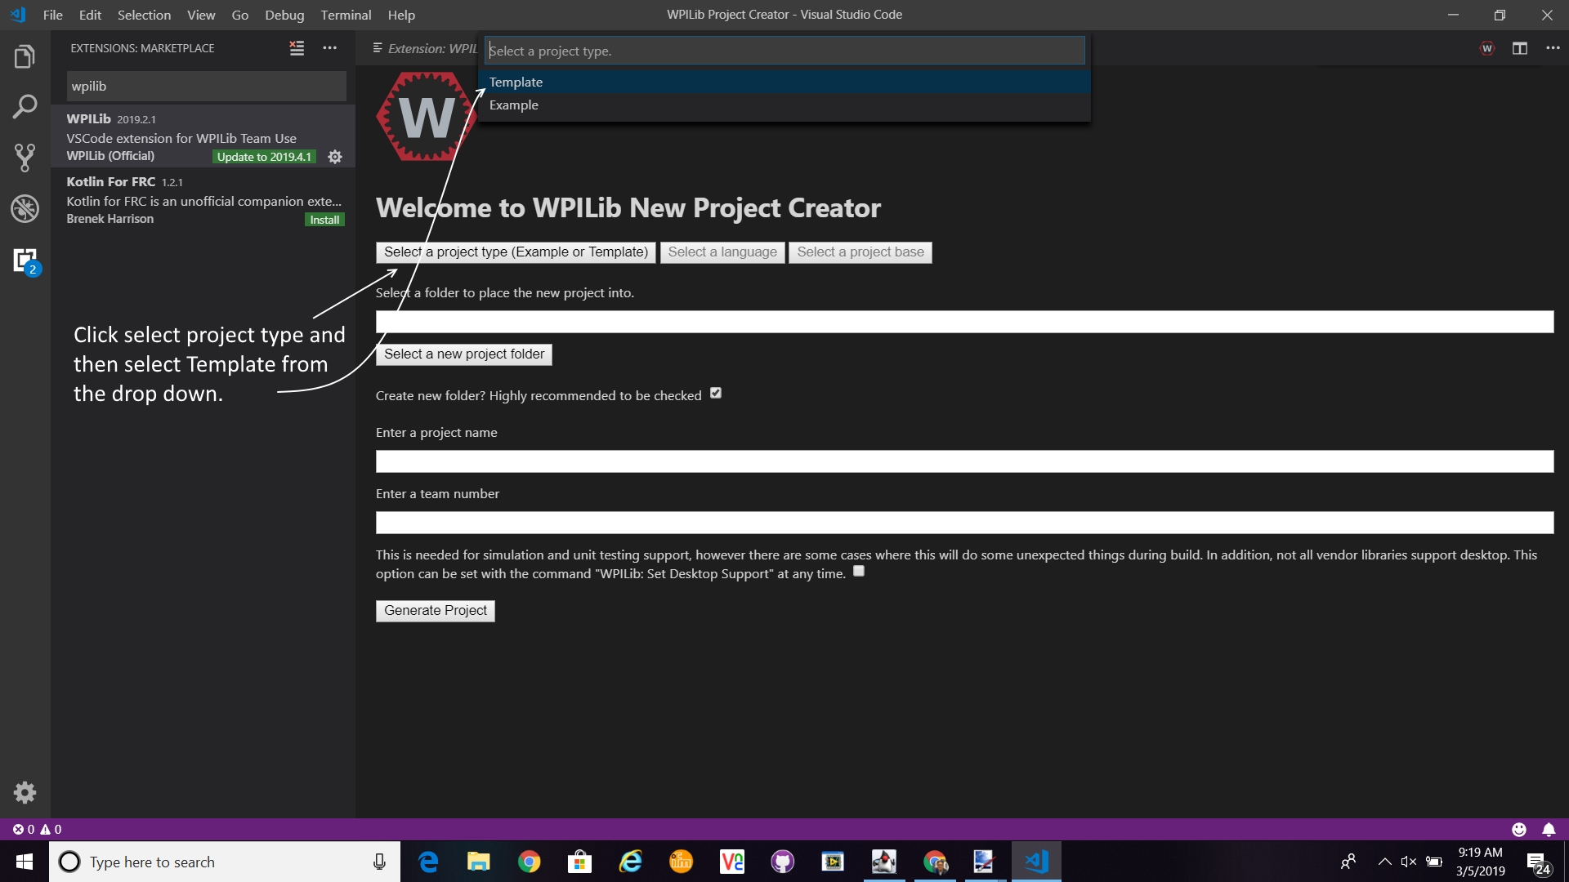

Slide 8
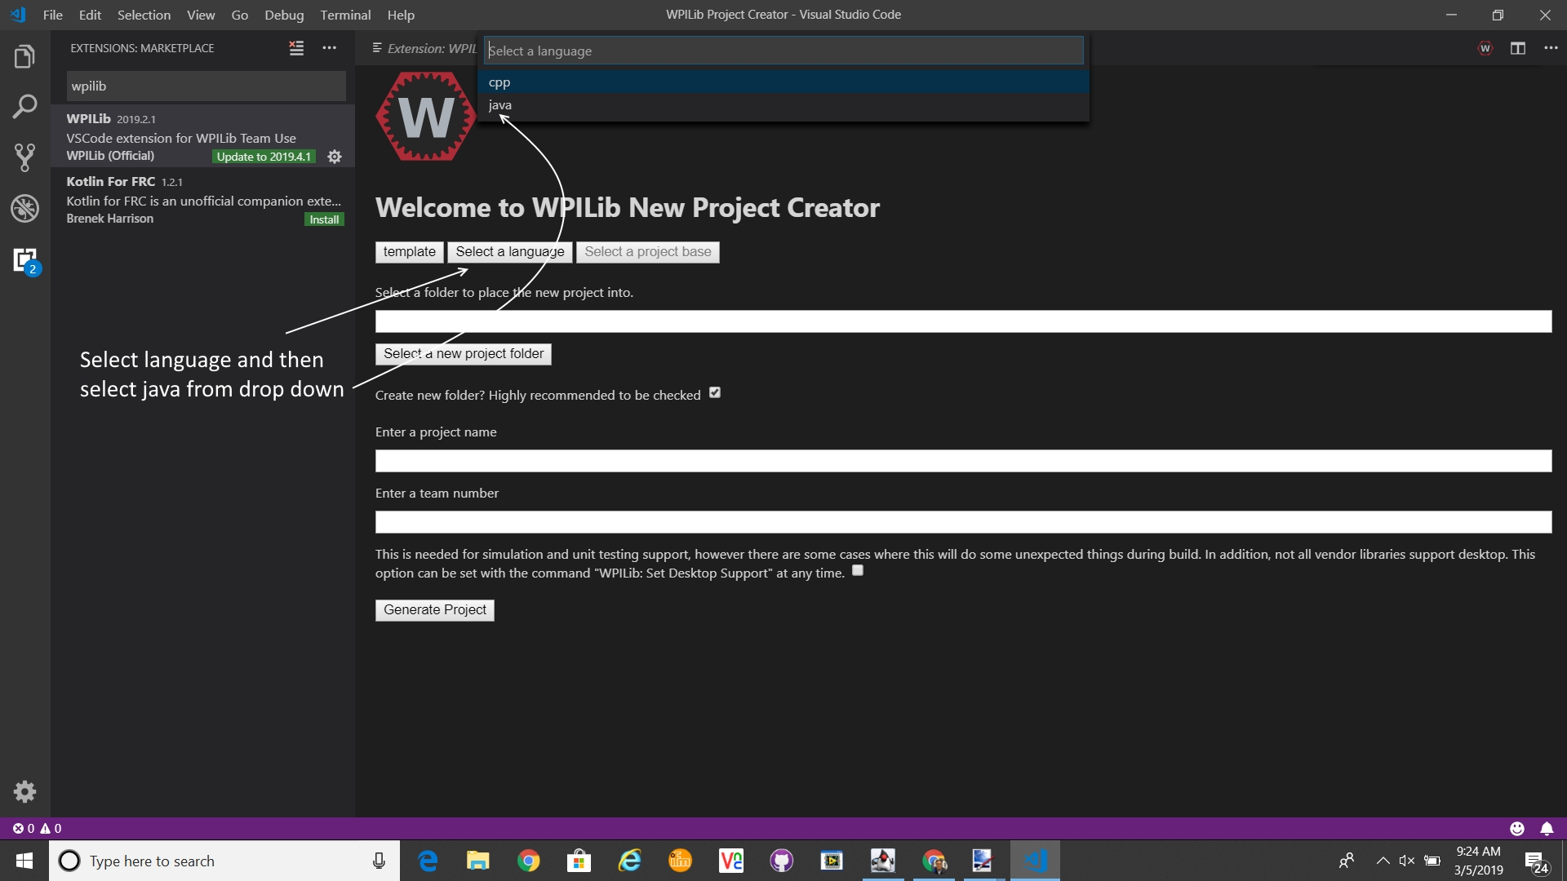

Slide 9
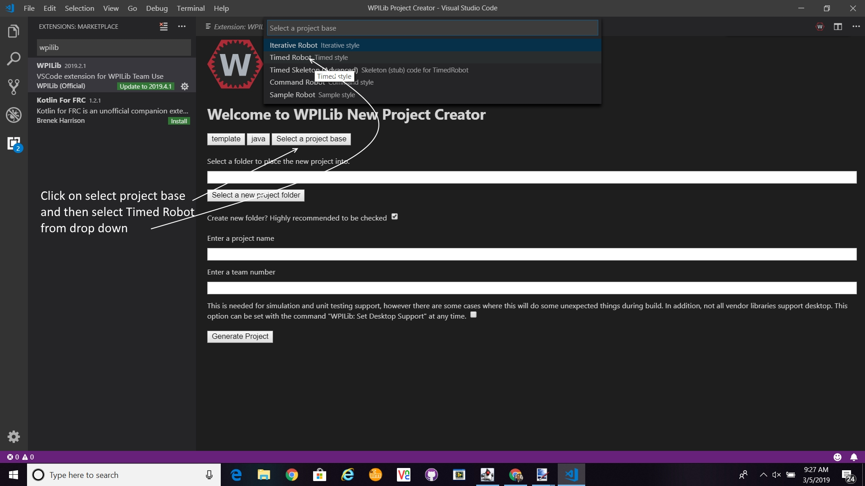

Slide 10
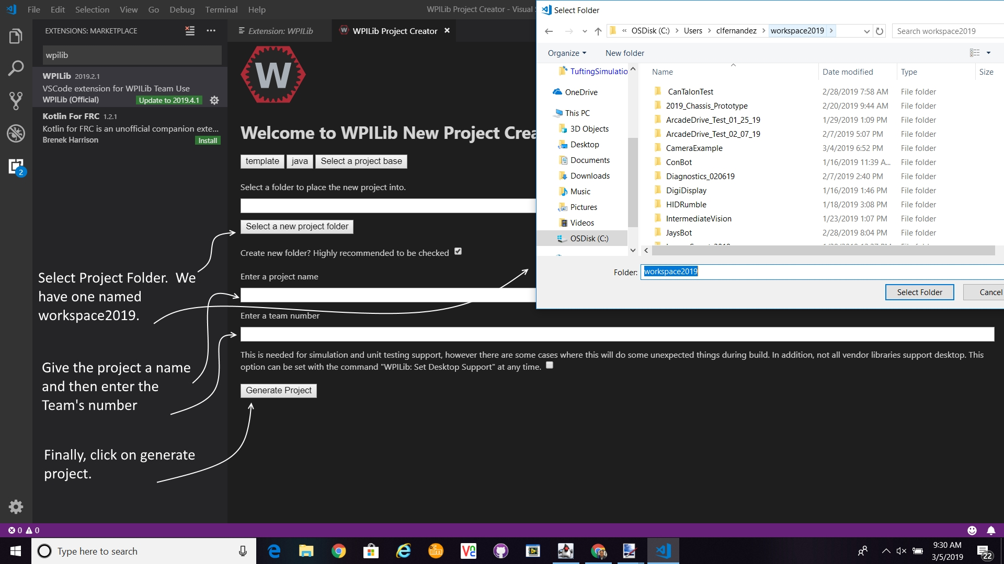

Slide 11
Congratulations, you just created your first project!!!!!
The following slide will show you what your program should look like.

Slide 12
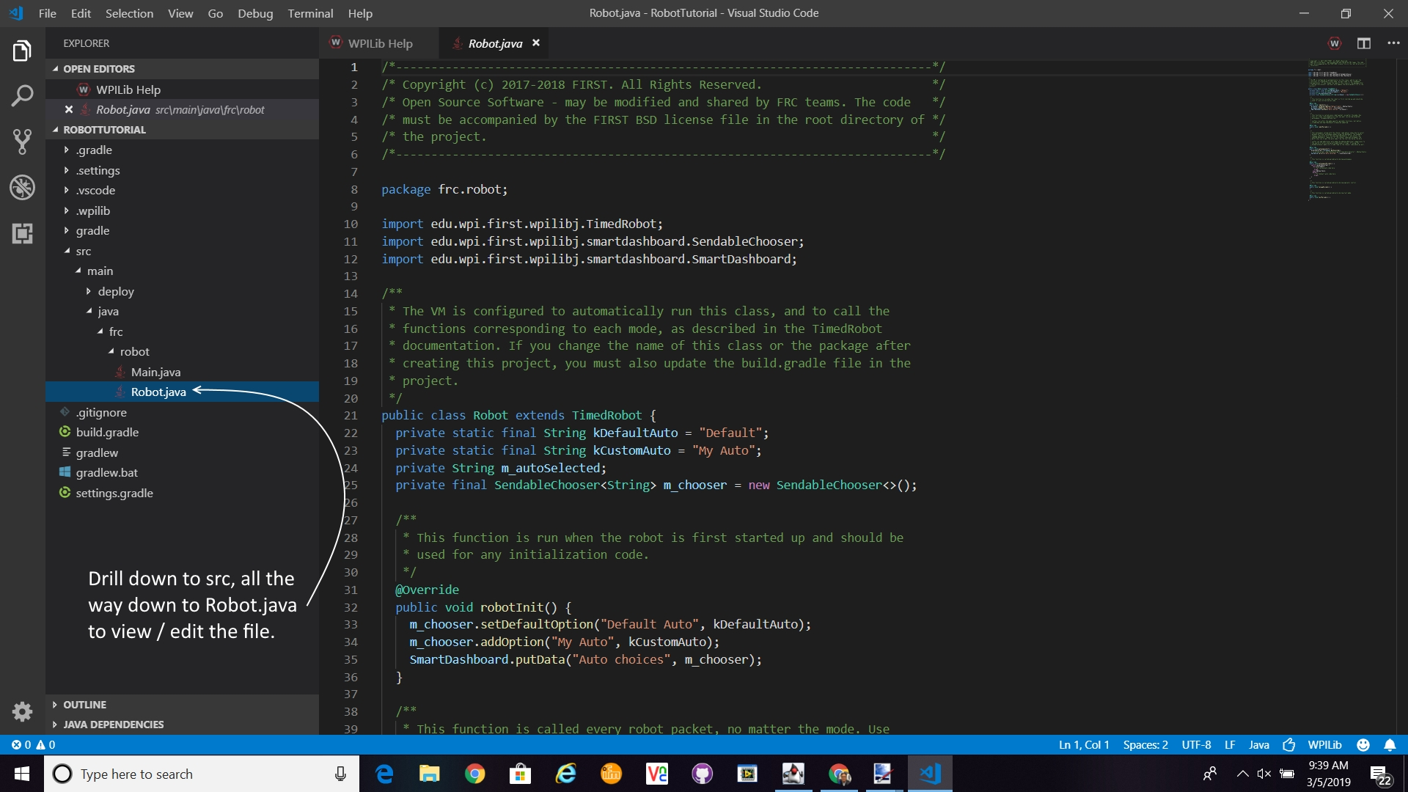

Slide 13
Let’s add some meat to the bones!
The template project will provide the structure needed to support your program. It has sections for autonomous init, autonomous periodic, teleop init, teleop periodic, and much more.
We’ll focus on teleop mode for now and add a joystick, drive train, solenoids. You pick what you would like to add and I will step you through the process.
The main steps are to add a reference to a specific library. Next, create the object ( motor, solenoid, sensor, camera, etc. ). Finally, do something with that object like run the motor forward or backward.
I promise that this will get easier the more you experiment!

Slide 14
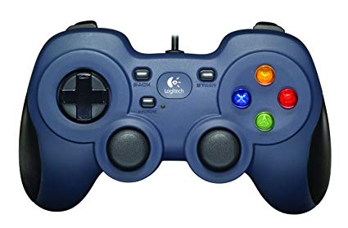
To control your robot, we will need a Joystick. How do you add a Joystick to your project?
First add a reference to the Joystick library. Next, declare a joystick variable. In the robotInit routine, you will set your joystick variable to a new Joystick object using channel 0.
After the Joystick object is created, we can use it in the teleOp periodic routine to control the speed of the robot motors and other robot components such as solenoids, lights, etc.

Slide 15
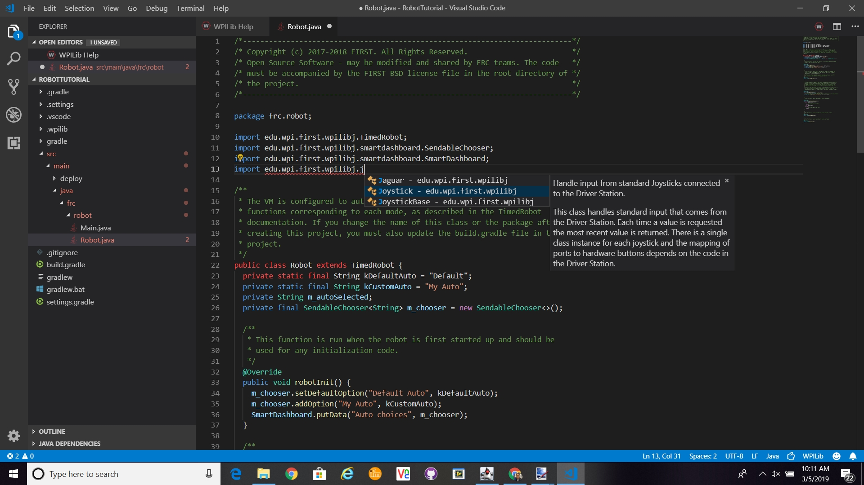

Slide 16
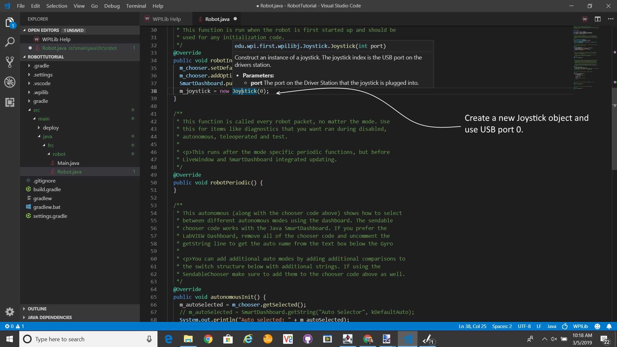
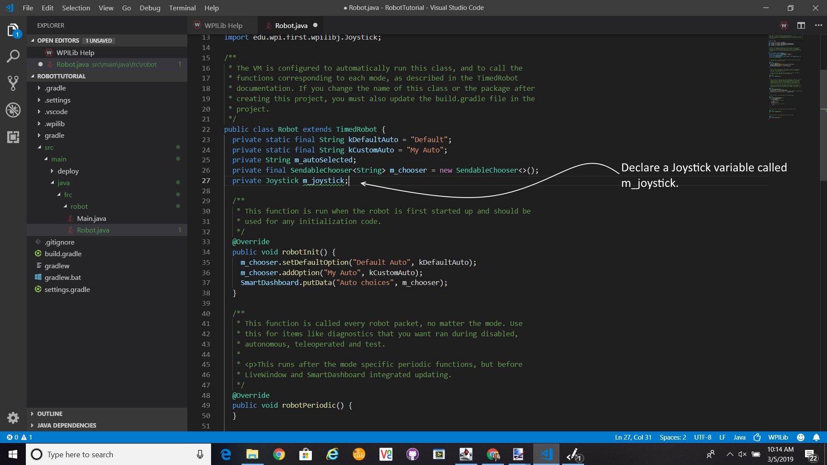

Slide 17
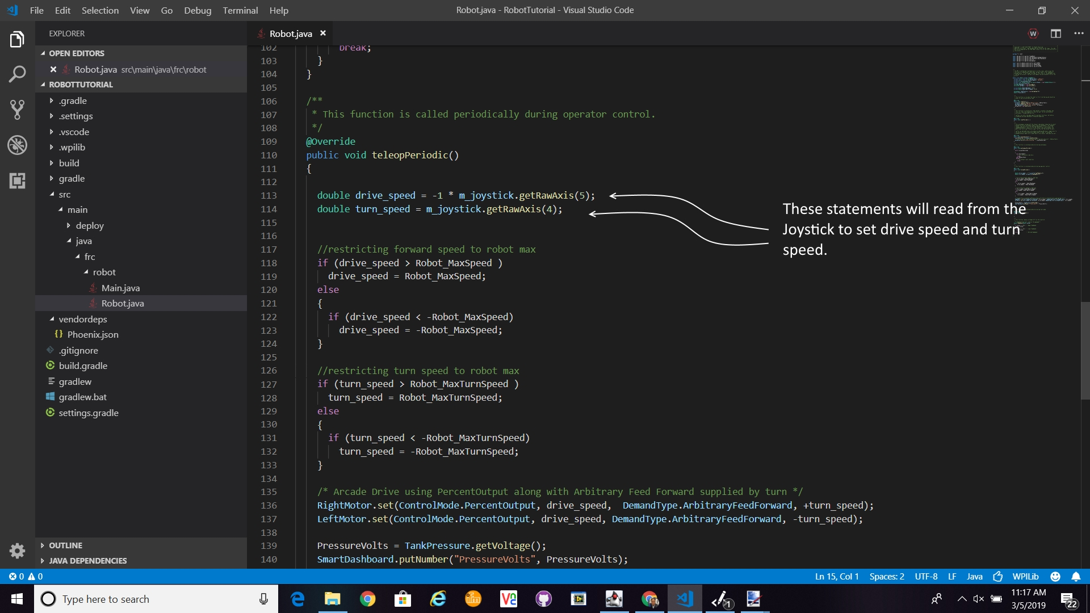

Slide 18
How do I add a camera to my robot?
To add a camera, you will need to add a reference to the camera server library. Then in the robot initialization method, you will need to call the start automatic capture method.
The following two slides will show you what the code will look like.

Slide 19
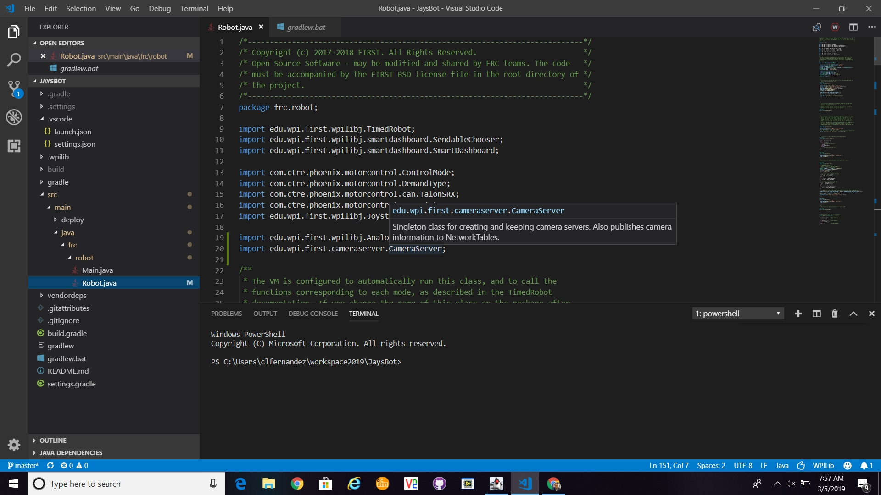

Slide 20
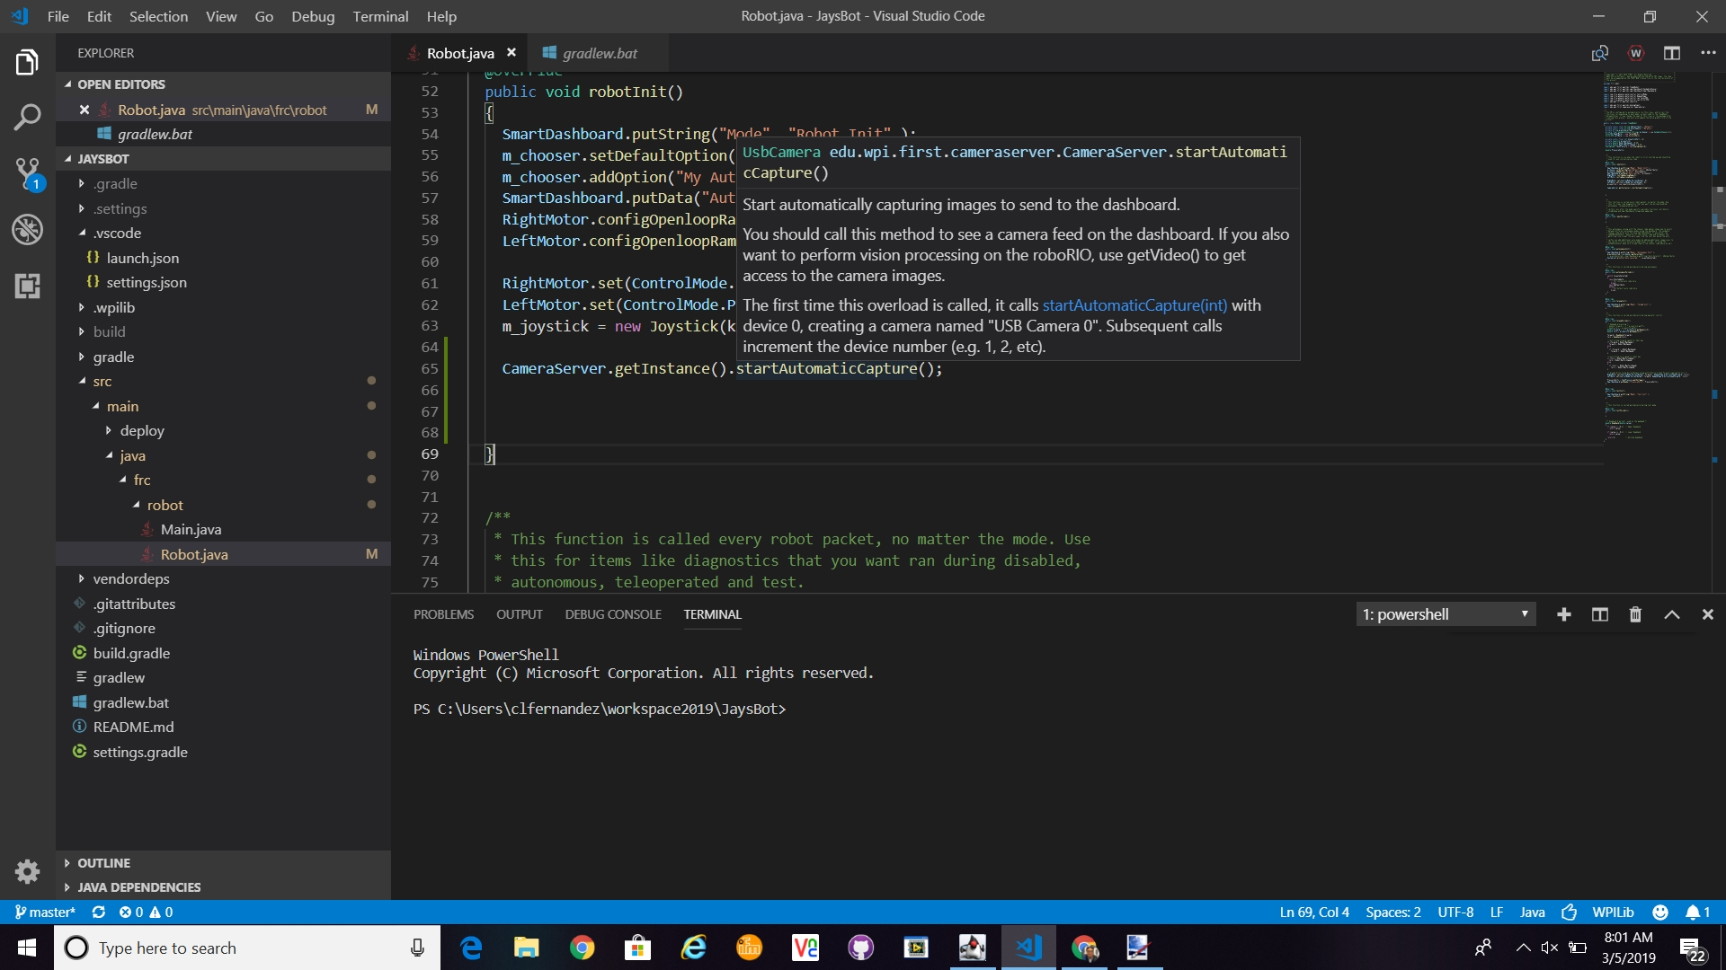

Slide 21
I have an analog sensor. How do I read information from the sensor?
Your sensor will need to provide a 0-5V signal. Wire the sensor output to one channel of the RoboRIO’s Analog Input ports.
In the code, you will need to add a reference to the analog input library. Next, create an instance of an analog input to the channel that you connected your sensor. There are four analog input channels ( 0 - 3 ). This will be a global object, so place the code inside the robot object and outside the robot methods. This will be clearer in the following images. Finally in the teleop periodic method, read the analog value from the sensor using the getVoltage method of the analog input object.

Slide 22
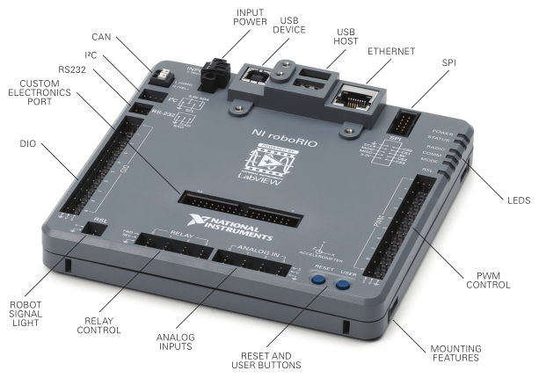
Notes:
At the bottom, you will notice the Analog Input ports of the RoboRiO.

Slide 23
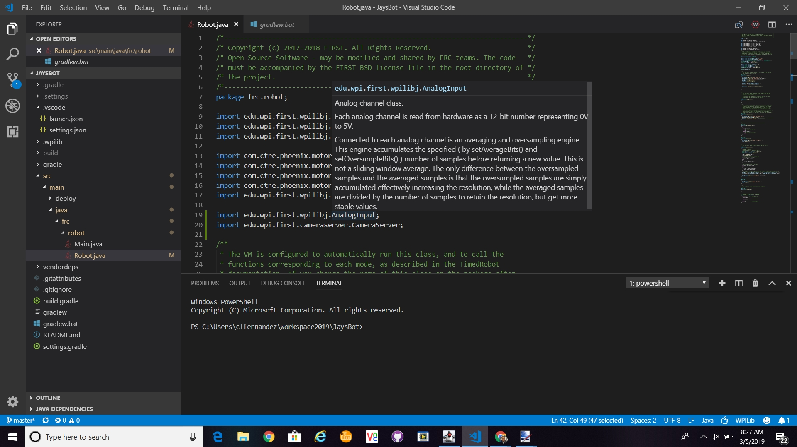
Notes:
Add reference to AnalogInput library.

Slide 24
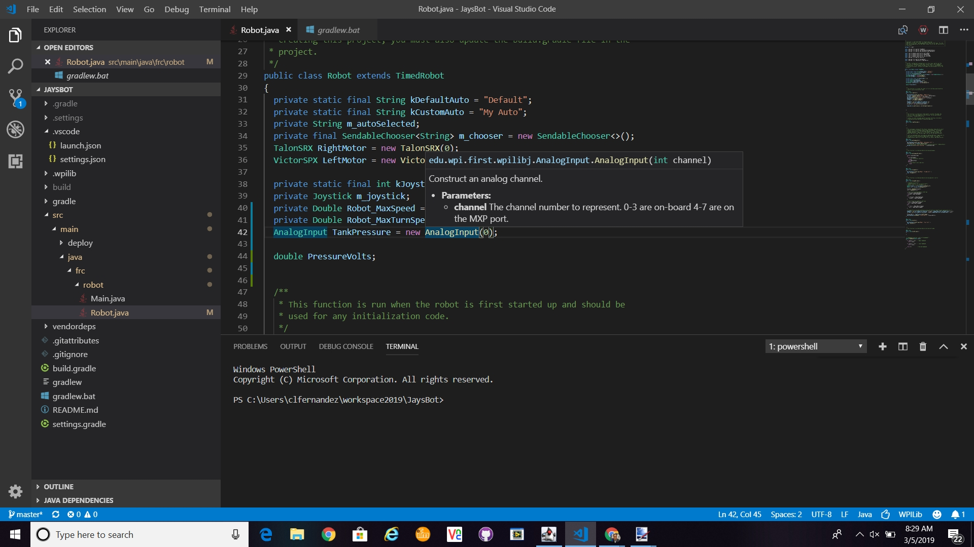
Notes:
Create an AnalogInput object and use channel 0.

Slide 25
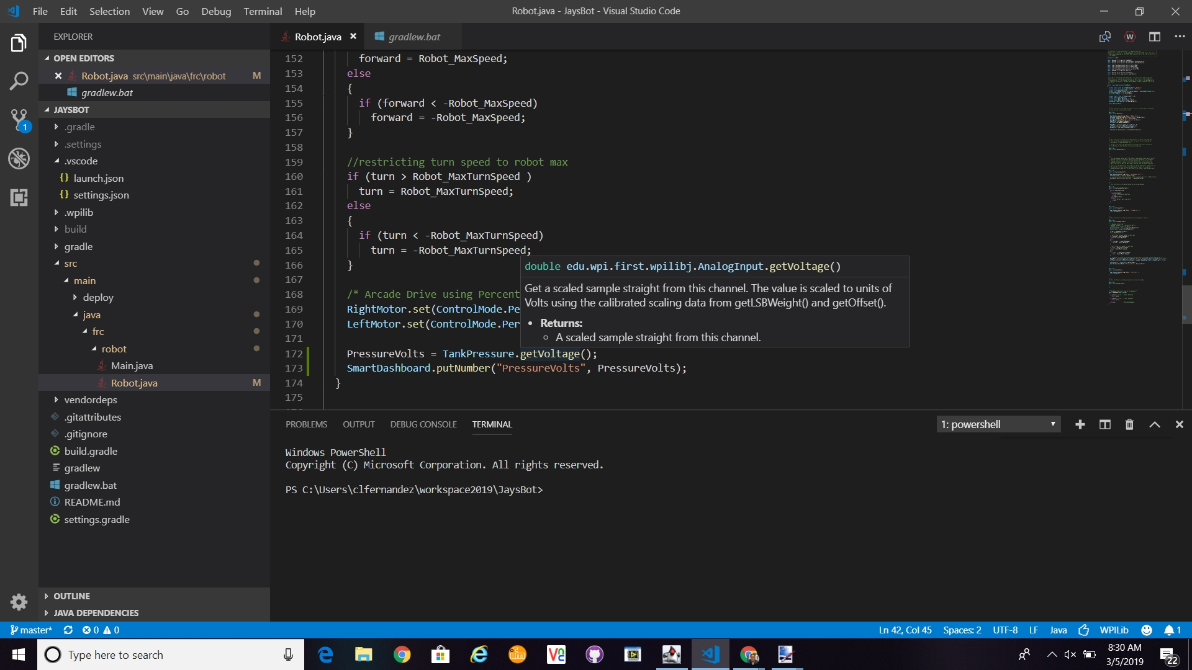
Notes:
Read the analog value using AnalogInput object’s getVoltage method.

Slide 26
Vendor libraries are no longer supported by WPILib. How do I install vendor libraries to use in VSCode?
In this example, we have a Talon SRX and Victor SPX motor controllers. They are manufactured by Cross the Road Electronics (CTRE).
They communicate via CAN bus, so I have the Talon SRX with ID of zero and the Victor SPX with ID of 1.

Slide 27
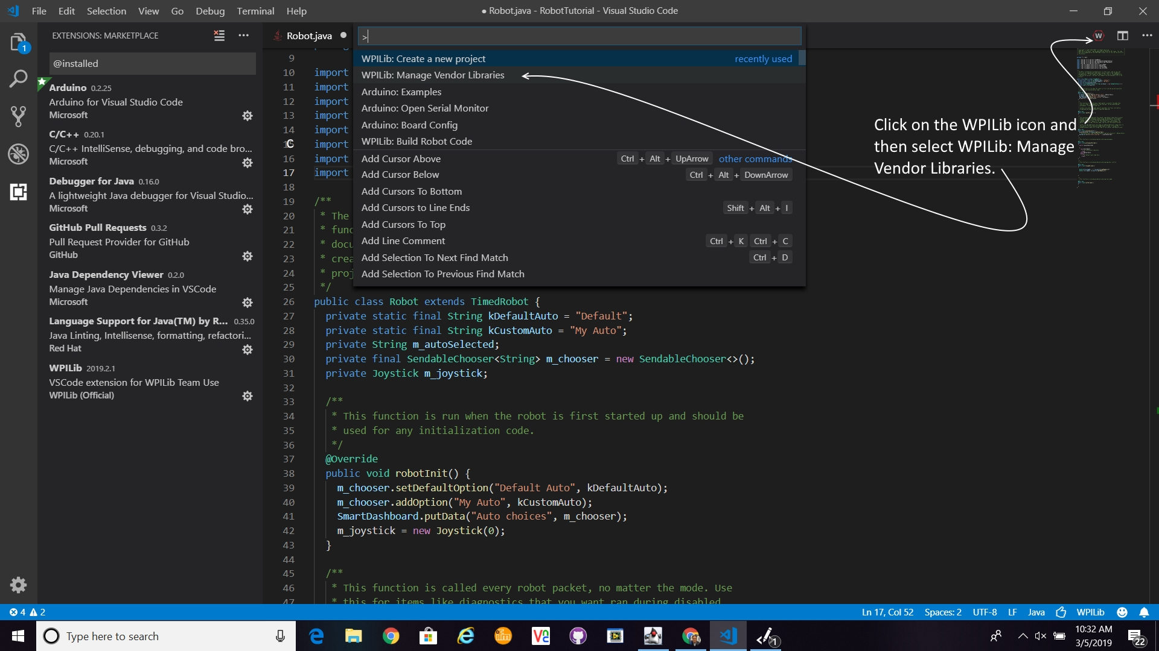

Slide 28
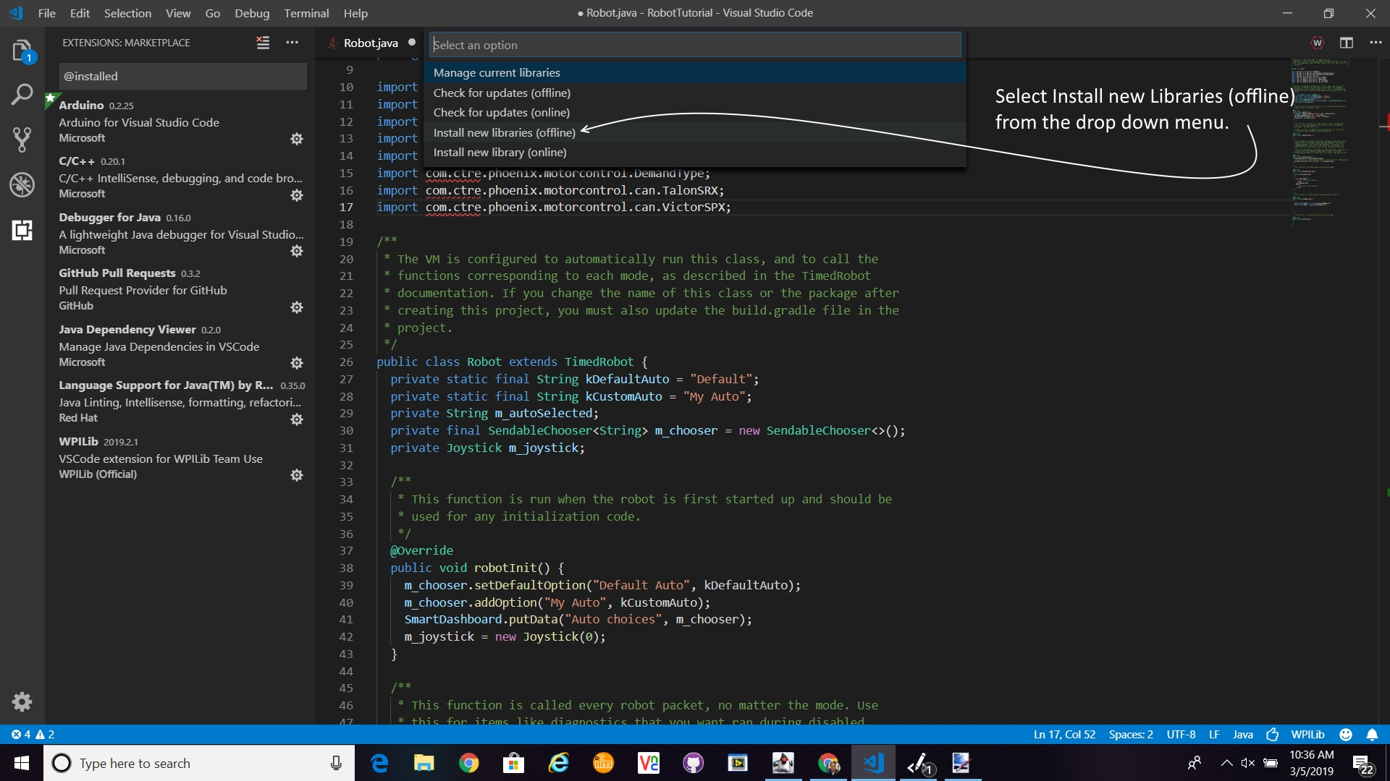

Slide 29
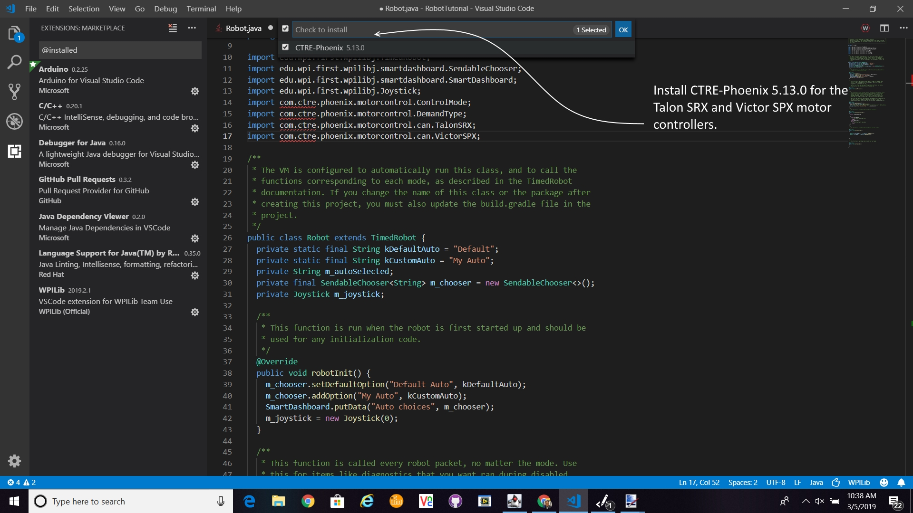

Slide 30
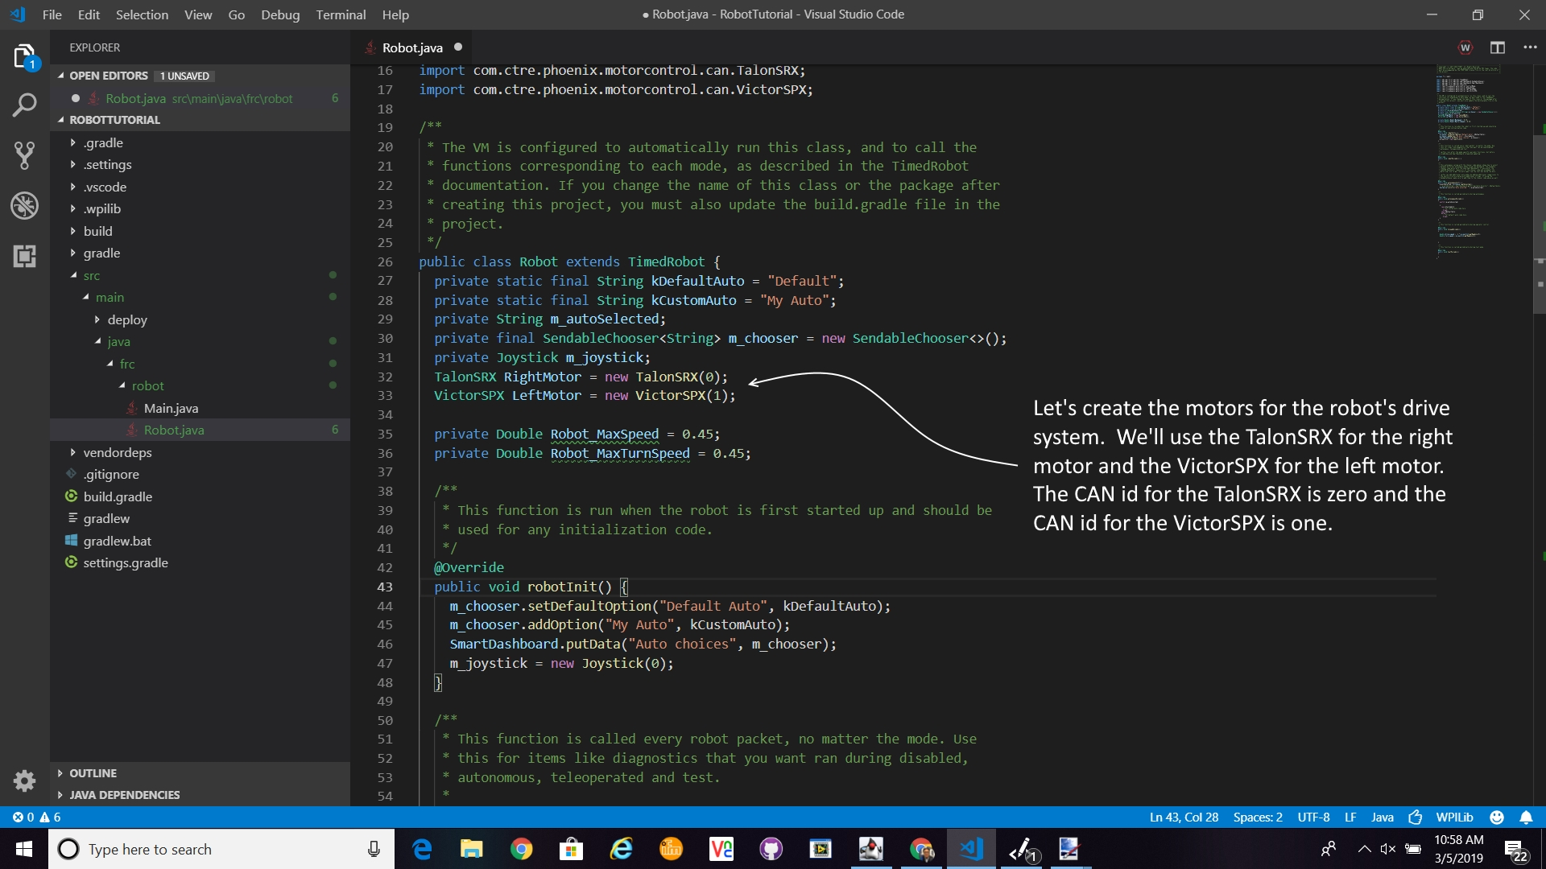

Slide 31
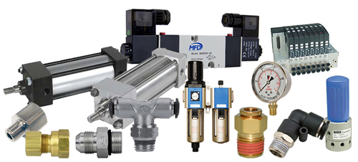
How do I add pneumatics to my robot?
This is a excellent article on programming pneumatics:

Slide 32
How do I build the robot code?
Building the robot code will compile the code and warn you of any error. Look for the three dots on the upper right of the Visual Studio Code screen and select Build Robot Code option.
This is shown in the next slide.

Slide 33
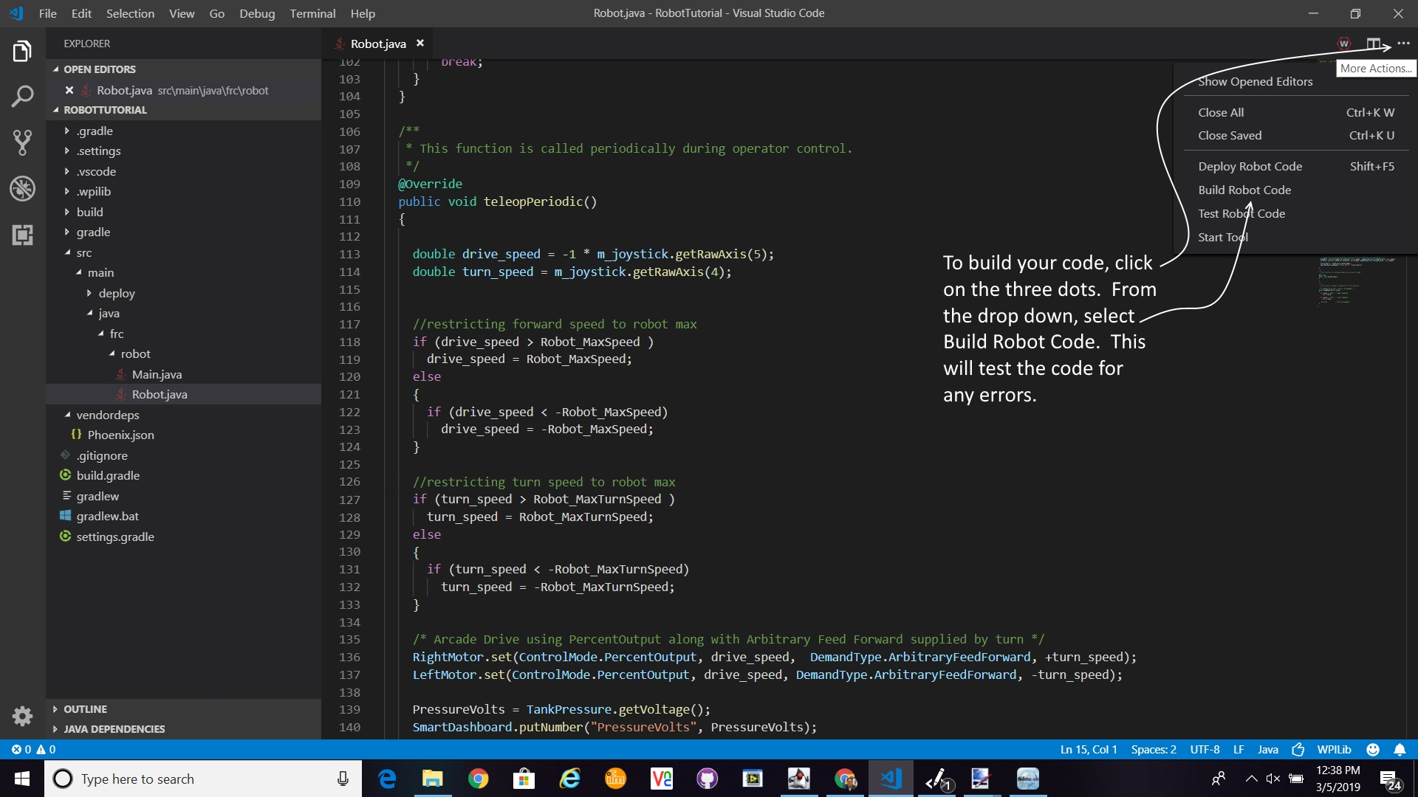

Slide 34
How do I download the code to the robot’s RoboRIO?
Make sure you are connected to the RoboRIO via an ethernet cable, USB cable or the radio access point. Once you are connected, you can click on the three dot icon on the upper right of the Visual Studio Code screen. Select the Deploy Robot Code option. The code will be compiled and downloaded to the RoboRIO.

Slide 35
